Slide 1
Sciencebois
Avery Pawelek
Negin Rahbar
Russel Gates
Tomi Ulobeko
Dylan Cooledge

Slide 2
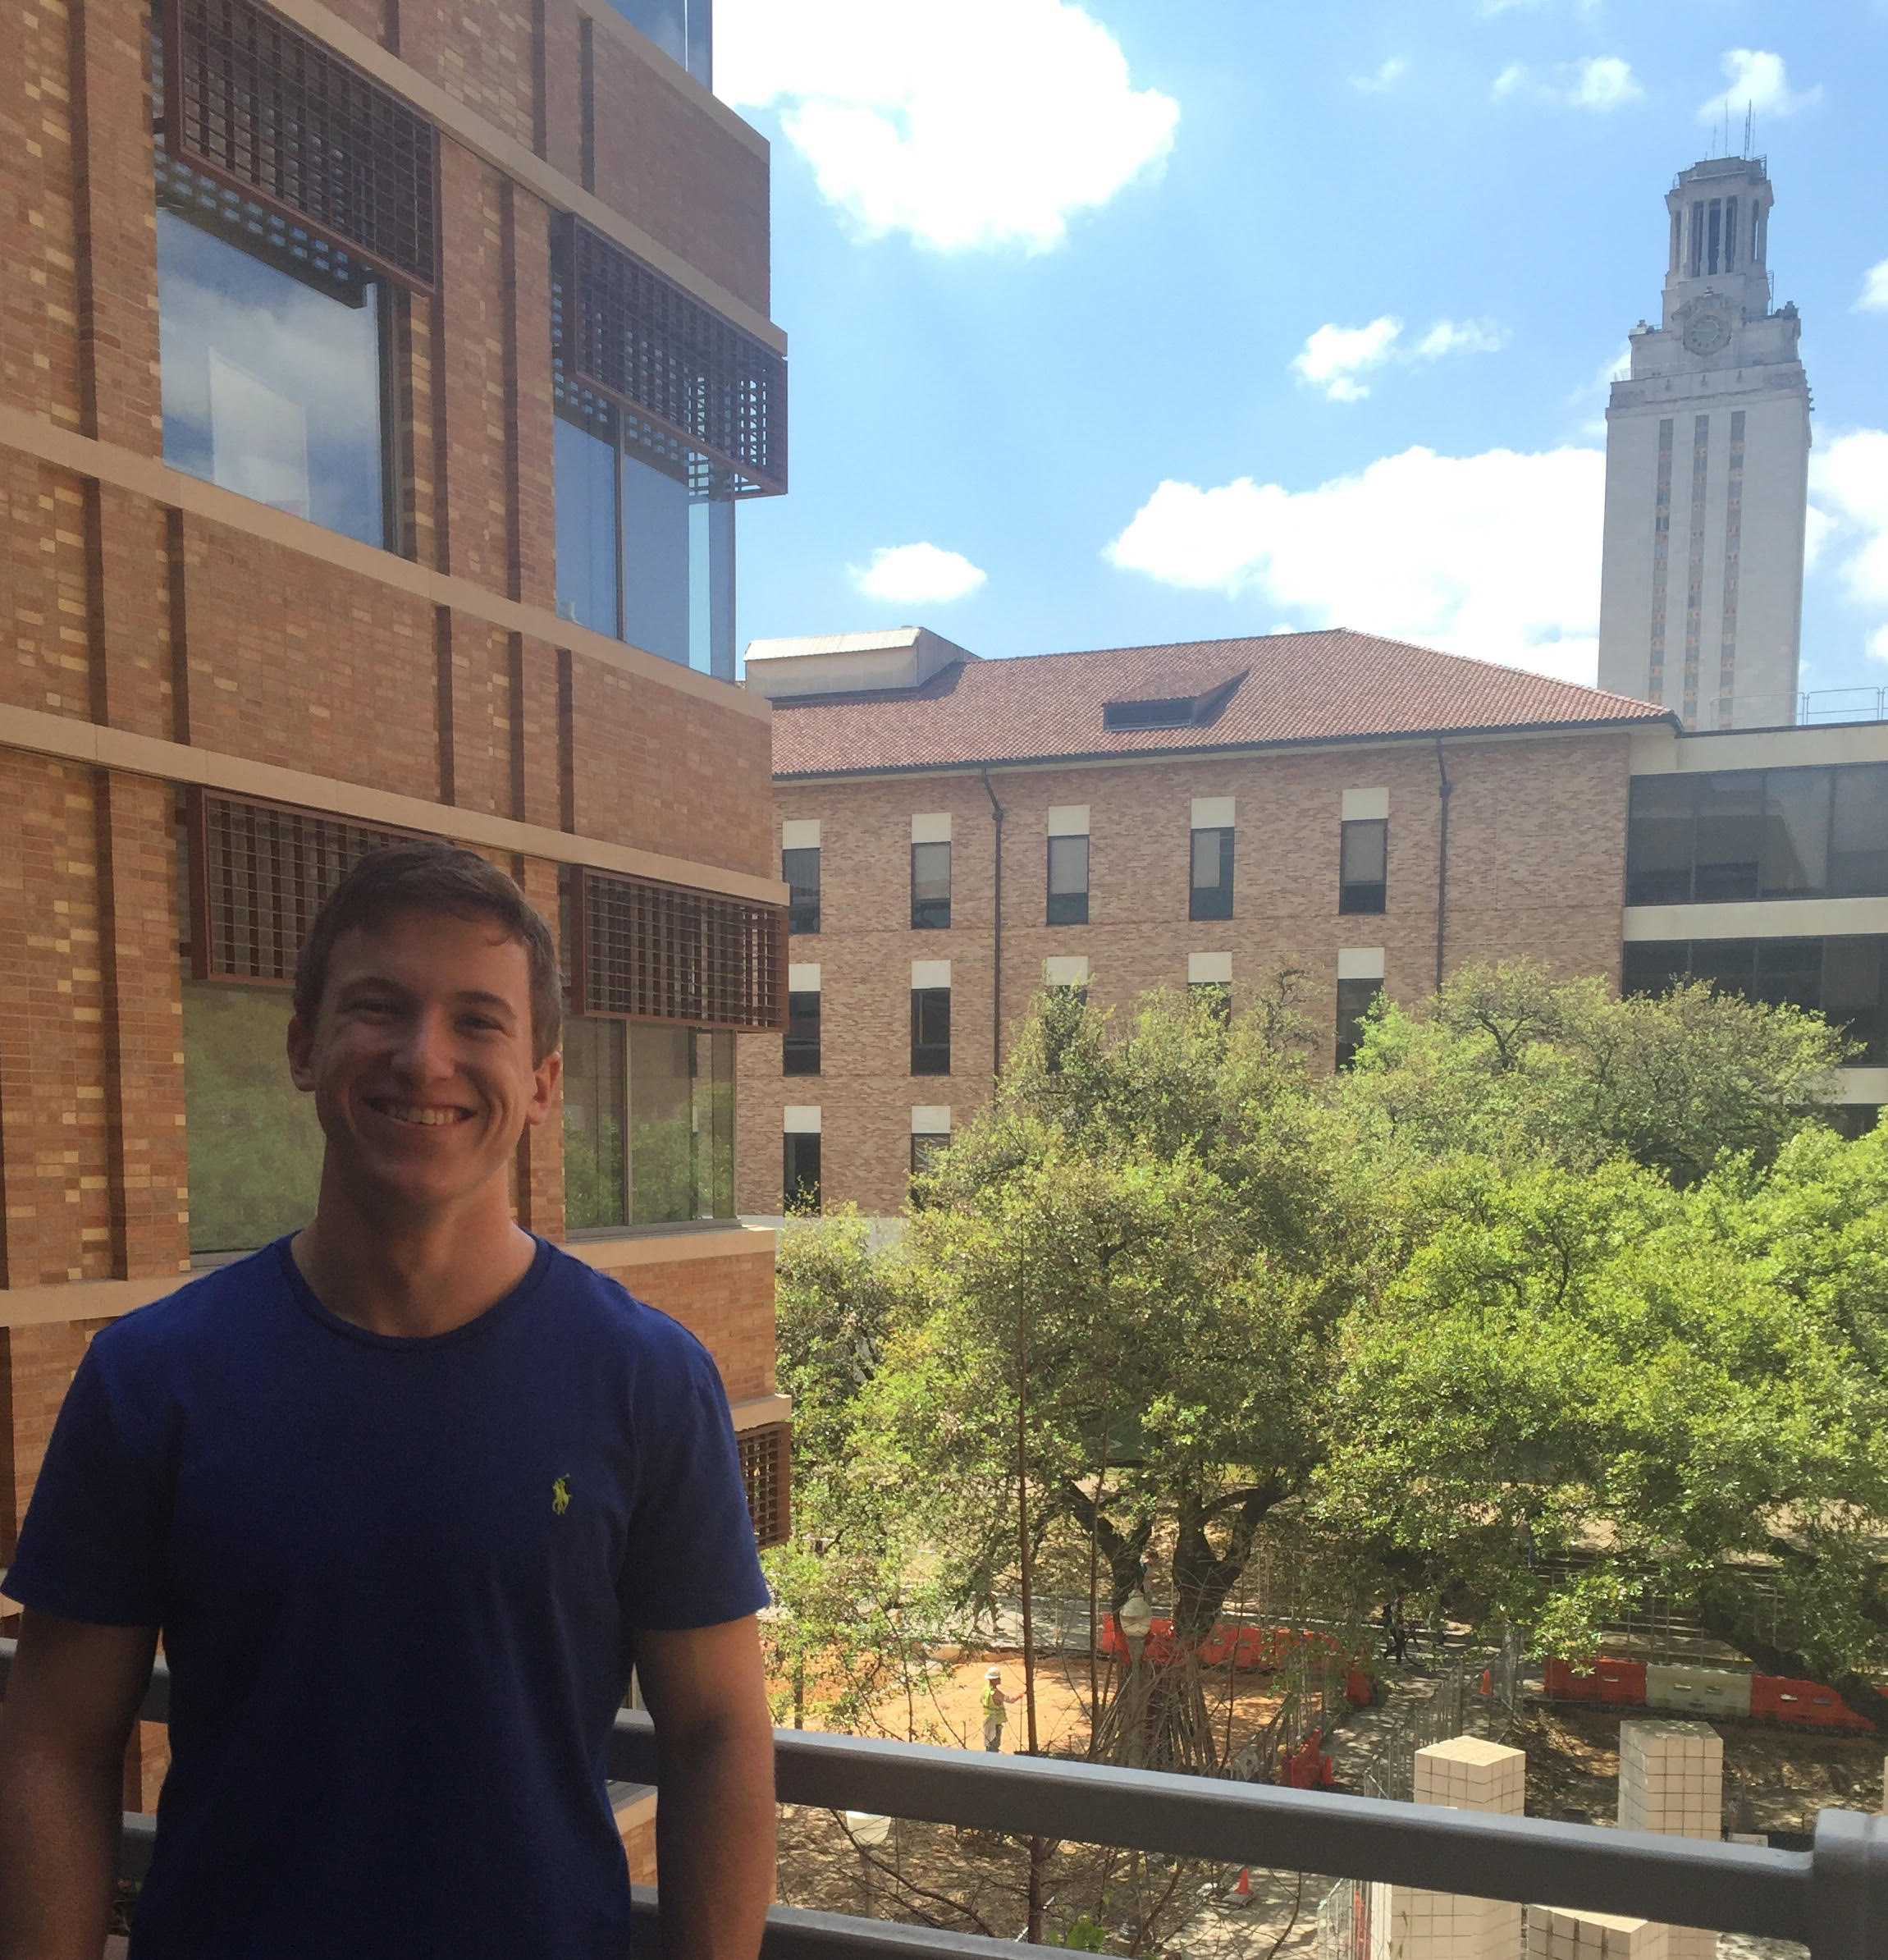
Avery Pawelek
I am a physics and mathematics student from a tiny town.
Responsibilities:
Scientific Fields model
Scientific Fields pages
Linking of pages
Meeting organizer
18 commits
11 issues

Slide 3
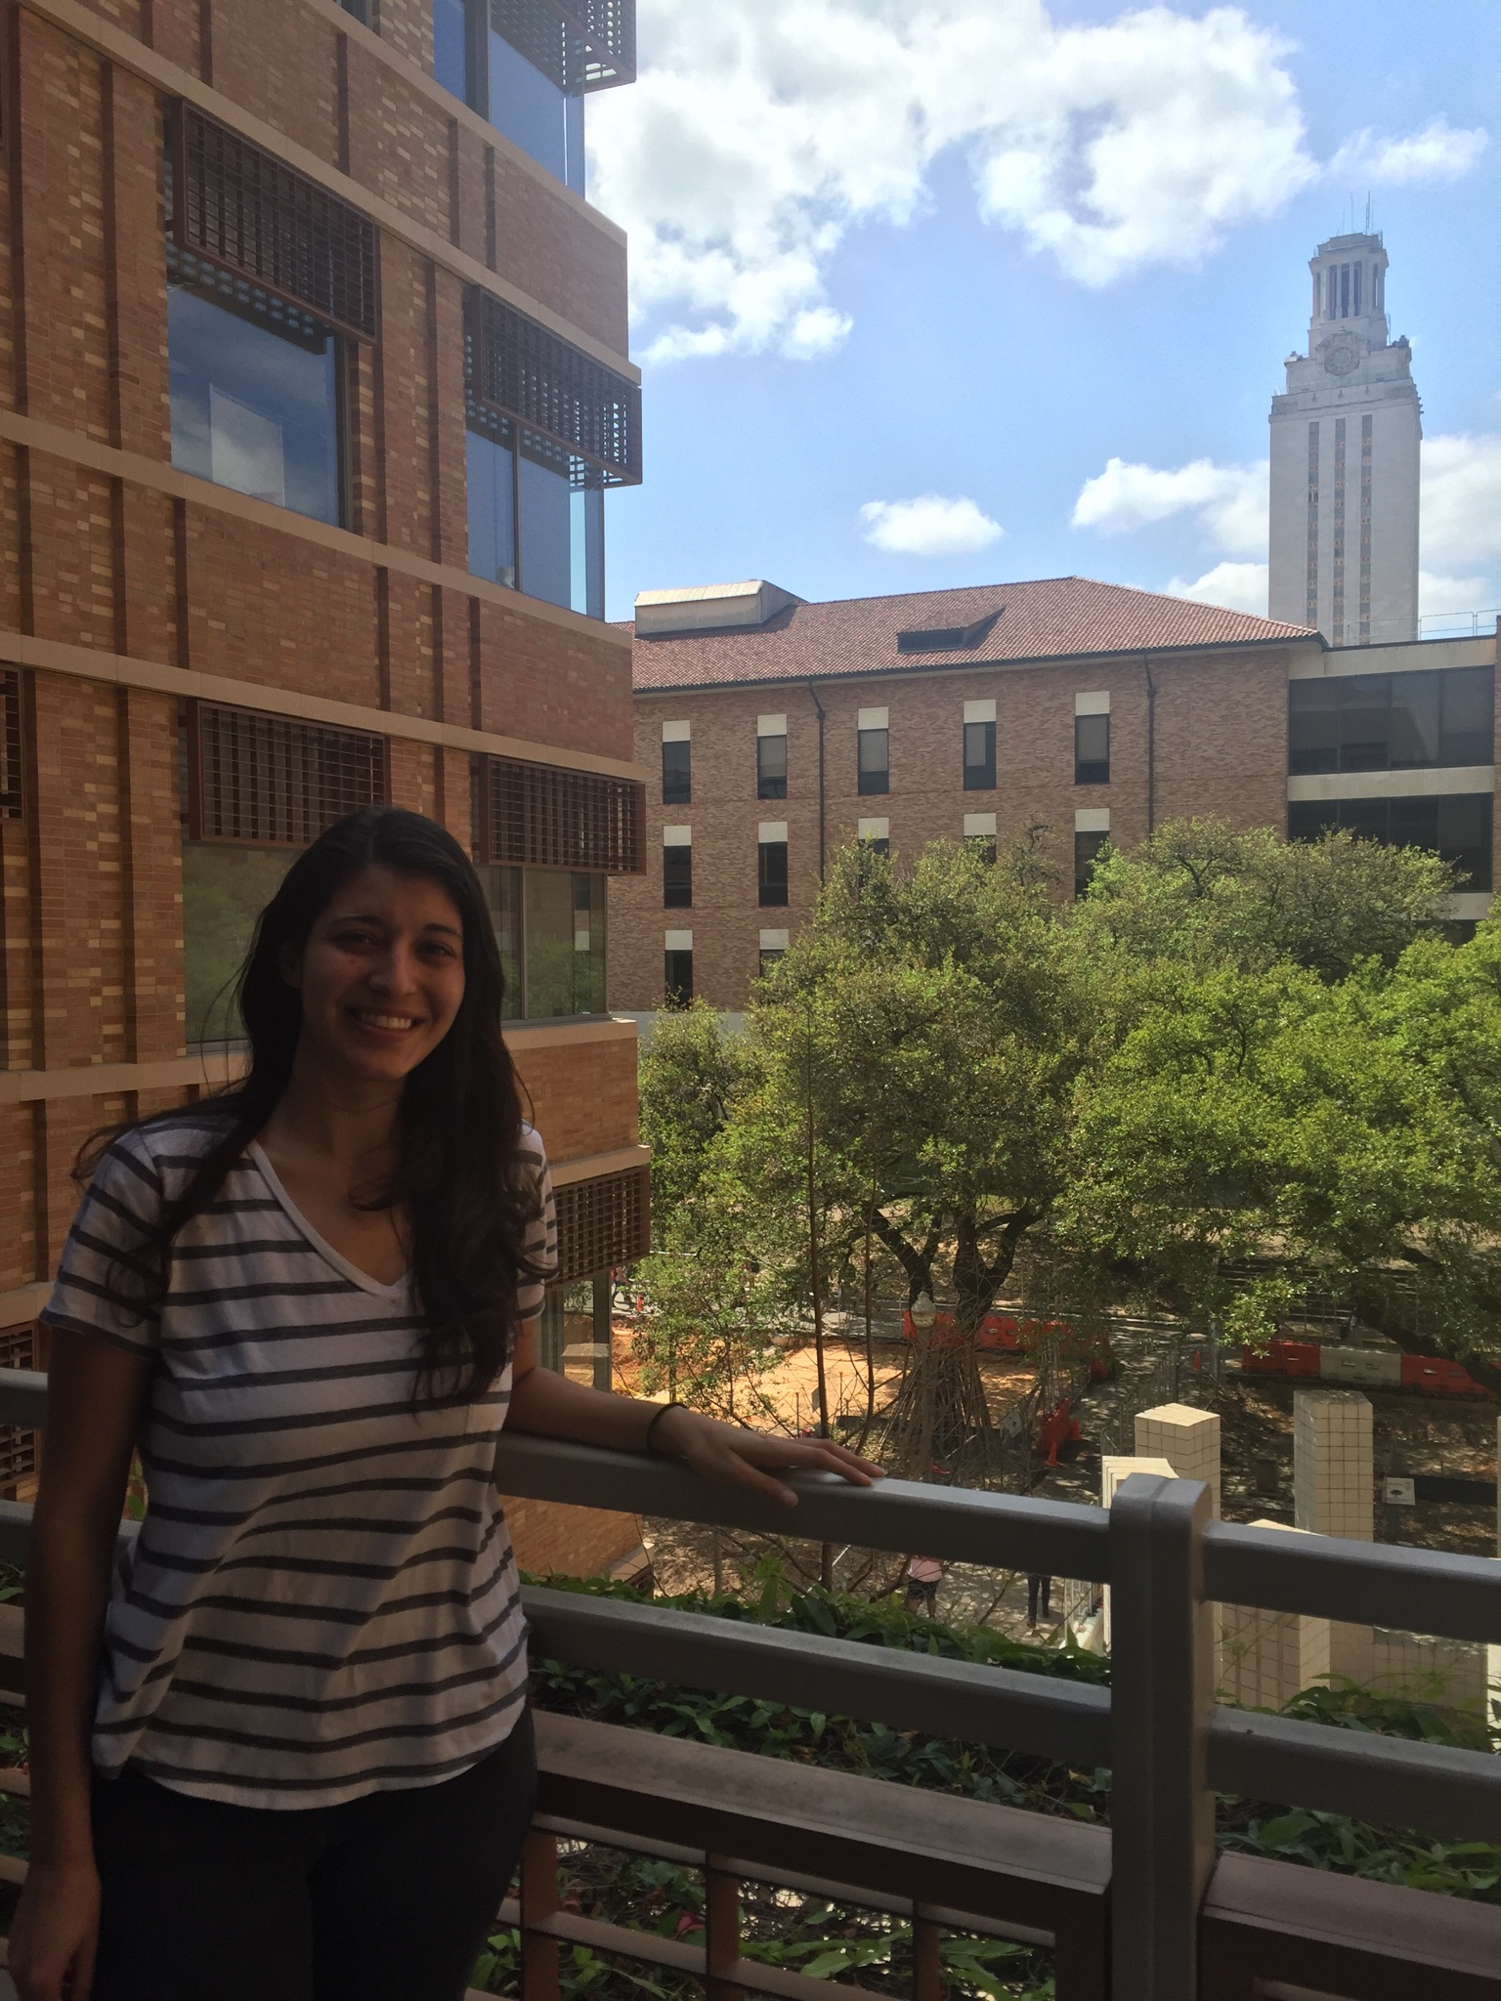
Negin Rahbar
I am not afraid to commit.
Responsibilities:
CSS
Technical Report
Splash page
9 issues
59 commits

Slide 4
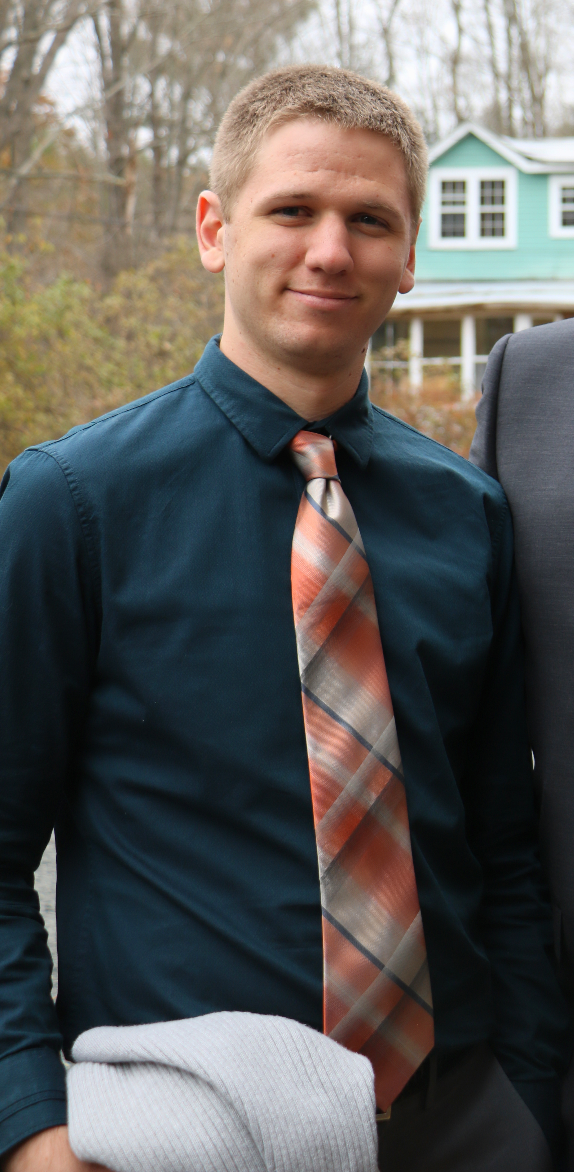
Russell Gates
Mathematics major at The University of Texas at Austin by day, Sm4sh noob by night.
Responsibilities
Hosting
Page Navigation
Documentation
23 commits
6 issues

Slide 5
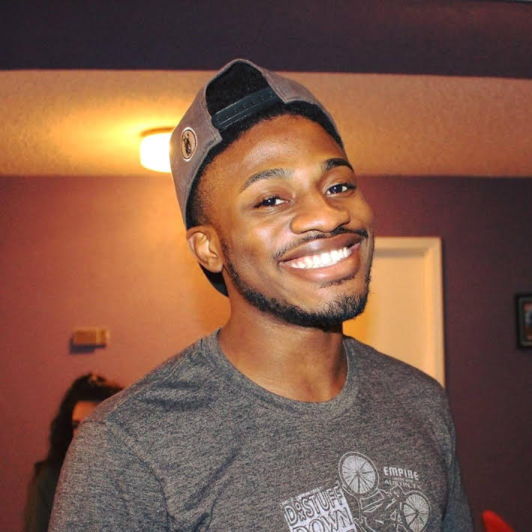
Tomi Olubeko
Mathematics Major at UT. I enjoy playing soccer and pwning Rusty at Smash.
Responsibilities:
Made the table for the theories
Made the theory html pages
8 (big) commits
9 issues
Added pagination to theorymodel.html
Added pagination to scientistmodel.html
Added pagination to fields.html

Slide 6
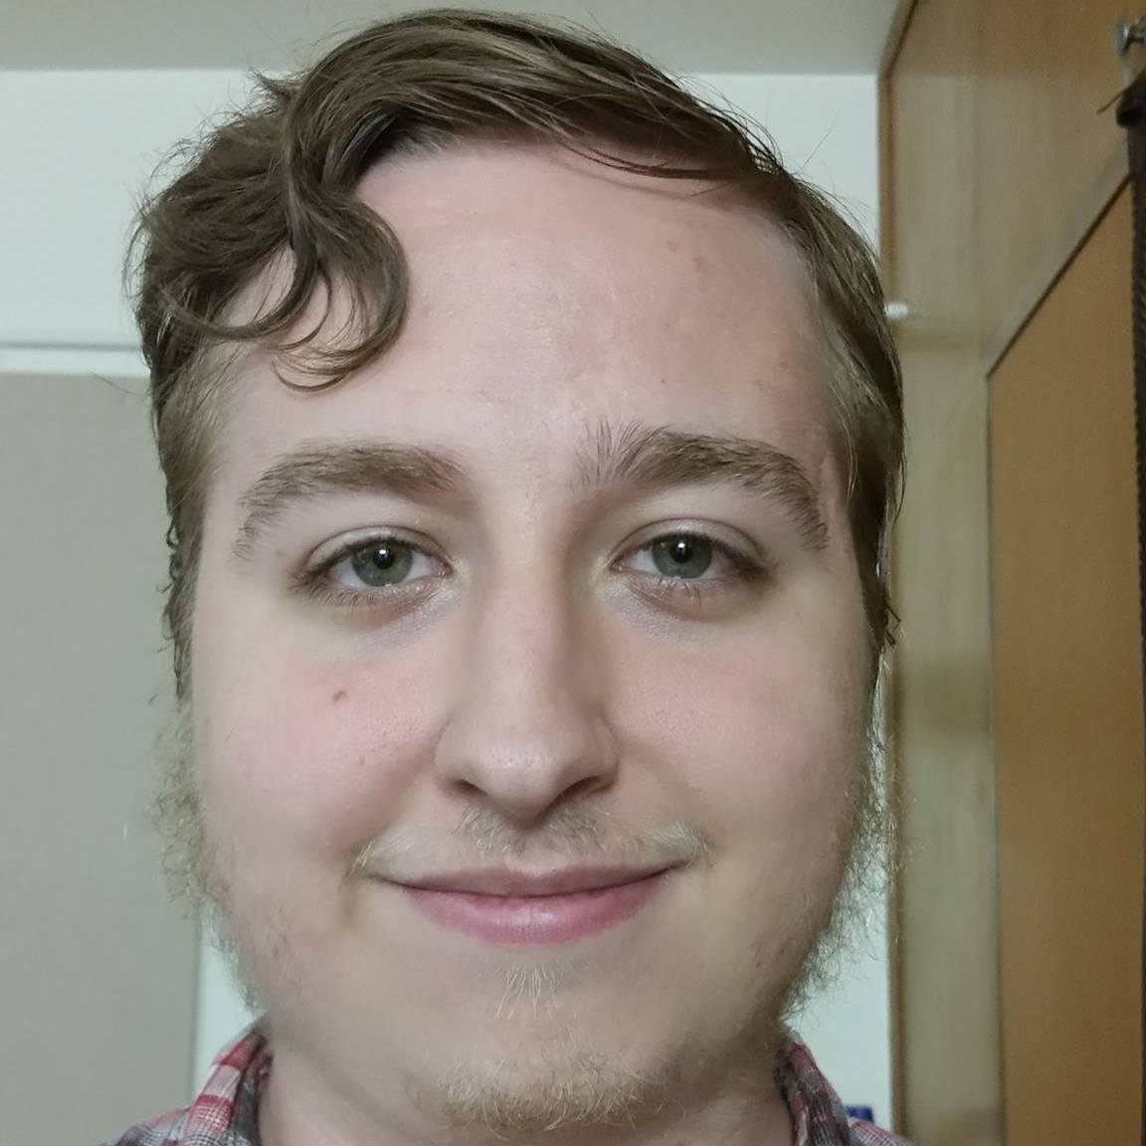
Dylan Cooledge
I like computer science and robots.
Responsibilities:
Scientists model
Scientists' pages
31 commits
11 issues (I made a good chunk of the issues, so my number is a little inflated)

Slide 7
Demo…

Slide 8
User Stories
The website should be hosted on Digital Ocean.
The backend must be implemented using Python and Flask.
Create presentation that showcases the user requirements and the developer response.
Implement the frontend using bootstrap.
The website should have sortable tables.

Slide 9
Self Critique
What did we do well?
We met as a group regularly throughout the week.
We made a plan and divvied up the work early so that we knew what we had to do early.
We got started early.
We communicated effectively.
What did we learn?
We learned basic html in order to create a website.
We learned how to host a website on git pages, then how to host it on Digital Ocean.
We learned how to use Flask for the back end of our website.
We learned how to use jquery, javascript, and css to make our website pretty.
We learned bootstrap to add functionality and a better UI to our website.

Slide 10
Self Critique
What can we do better?
We can make the UI a bit better.
We can add more content to our website. More specifically, find a balance between the content and the work needed to add the content.
Work together more often, so everyone has a sense of the scope of the project.
What puzzles us?
For some reason our repository had trouble linking up with namecheap, and we were unable to spot the error before the due date of the second project.
Why didn't we use bootstrap from the get go to make our website pretty? Implementing it overrided much of the css work we did.

Slide 11
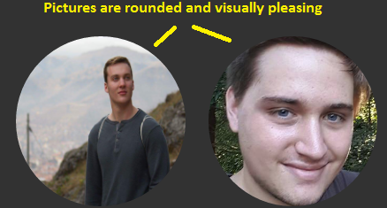
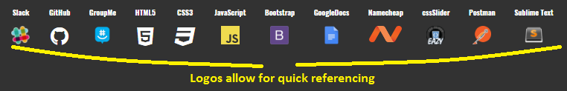
Critique of Group 2
What did they do well?
Group two's about page is very well done. The placement of the pictures is really good, and the UI looks engaging.
Group two's use of relevant logos in their about page allows the user to easily see the tools used as well as provide a link to each cool.
Their tables were clear, concise, and easy to parse through and understand.
Their home page was very funny.
What did we learn from them?
Group two's project was essentially about authors, their most highly rated books, and the publisher's these books were published under.
We learned about good authors and the books that they wrote, as well as who published them.
We also learned a little bit about these authors, such as their birth year, their hometown, and when they first published a book.

Slide 12
Critique of Group 2
What can they do better?
The whole website was presented very well, in a clear and concise manner.
However, there was very little information actually gathered and presented. For example, we barely know anything about the authors, and we know virtually nothing about the books, except the title, and that it was the highest rated book by a particular author.
What puzzles us about their website?
The main thing that puzzles us about Group two's website is why they chose to use the logo as the only way to link to the html pages for the publisher's and books, and the author's picture as the only way to link to the author's pages.

